Slide 1
Issues with math & special variables
A side lesson into java math and Final

Slide 2
Problems with Data types
Remember that both int and double represent integers and floating numbers respectively
When doing math with these number, some issue might arise

Slide 3
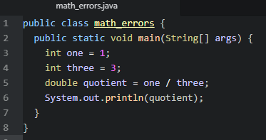

Division
While this output should be 0.333… its not
Its 0, but why?
Since the division is done with int, the final answer can also only be and int

Slide 4
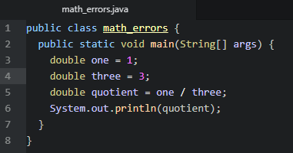

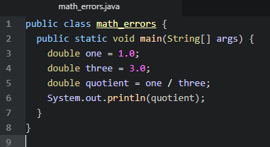
The solution
While turning our other variables into double is a solution, it not a ‘proper’ solution
When creating variable that represent whole numbers in double, add the .0 at the end. While Java accepts the other way, it a good type to make int and double different

Slide 5
final
Many times when we create programs we create variable that won’t ever be change or constants
This is brings in the final ‘attribute’

Slide 6
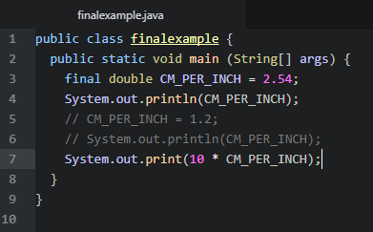
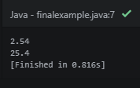
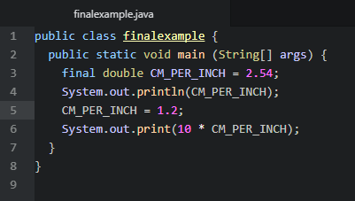
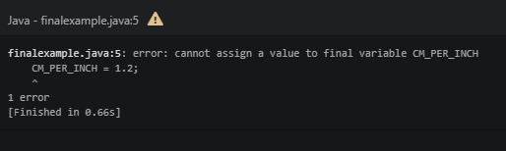
Using final

